Slide 1
FINAL YEAR PROJECT · CSE
AI Website Builder
Plain-English prompts become live, exportable websites
Flask + ML
Offline Export
Instant Preview
Notes:
Introduce the project: an offline Android app that gives visually impaired users spoken hazard warnings.

Slide 2
01 · INTRODUCTION
Introduction
Building a professional website still demands coding skill, design sense, and money that students, individuals, and small businesses often don't have. Even modern website builders require manually browsing templates and assembling sections by hand. This project lets a user simply describe the website they want in plain English and get a themed, ready-to-edit site back instantly.
Websites Need Skills
Coding, design, and budget keep many people from building a site at all.
Builders Still Demand Effort
Even drag-and-drop tools require manually picking templates and sections.
Language-First Alternative
This project turns one plain-English sentence directly into a finished site.
AI WEBSITE BUILDER
02
Notes:
Frame the problem for the audience and state what the app does in one breath.

Slide 3
02 · PROBLEM STATEMENT
Problem Statement
Hiring a developer or learning HTML/CSS/JS is slow and expensive, while drag-and-drop builders still force users to pick templates and sections themselves. AI-assisted builders that accept a text prompt exist, but they are closed, cloud-only, and unaffordable for a student team to study or replicate. The result is a persistent gap between a person's plain-language idea and a working website.
Commercial Builders Need Manual Assembly
AI Builders Are Closed Black Boxes
Wix/Squarespace still require browsing templates and placing blocks by hand.
Hosted tools like Durable hide their models, need subscriptions, and offer no offline mode.
Research Pipeline Needs Heavy Compute
No Honest Confidence Signal
The base paper's transformer + RL pipeline needs GPUs and datasets a student team lacks.
Existing tools return an answer regardless of certainty, with no warning when a guess is shaky.
AI WEBSITE BUILDER
03
Notes:
Four failure modes of existing tools; land on why on-device matters.

Slide 4
03 · OBJECTIVES
Project Objectives
1
Dual Classifiers — Train TF-IDF + logistic regression models to predict site type and required sections from free text.
2
Rule-Based Extraction & Theming — Build regex/word-list rules that pull name, contact, and tone cues into a matching palette and fonts.
3
Assembly & Rendering Pipeline — Combine predicted sections with a navbar/hero/footer and render a live responsive preview via Jinja2.
4
Offline Export — Package the previewed site into a dependency-free ZIP that runs with no server or internet.
5
Confidence Transparency — Design a visible low-confidence warning based on probability, vocabulary coverage, and prompt length.
AI WEBSITE BUILDER
04
Notes:
Five objectives, read as commitments for the year.

Slide 5
04 · LITERATURE SURVEY
Literature Survey
Key Findings from the Paper
BASE RESEARCH PAPER
The base paper proposes interpreting free-text requirements with transformer NLP (spaCy/Hugging Face), generating layouts with generative design models, and optimizing content placement via reinforcement learning, deployed as a containerized Flask/Django service on Vercel.
"AI Website Builder"
Research Gap Identified
Transformer fine-tuning and RL layout optimization need GPUs and labelled datasets a student team doesn't have; this project substitutes lightweight scikit-learn classifiers and rule-based templates that train in seconds and run fully offline on a laptop.
AI WEBSITE BUILDER
05
Notes:
Base paper is HazardNet; state the gap it leaves open.

Slide 6
05 · COMPARISON
Research Paper vs. Proposed System
RESEARCH PAPER
YOUR APPLICATION
Transformer NLP (spaCy/Hugging Face) for prompt interpretation
TF-IDF + logistic regression classifiers trained in seconds on a laptop CPU
Generative design model for layout creation
Fixed library of hand-written responsive templates chosen by simple rules
Reinforcement learning to optimize content placement
Deterministic per-type section ordering, fully explainable in a viva
Containerized Flask/Django deployment on Vercel
Single local Flask app with SQLite storage, no cloud hosting required
No stated reliability signal for generated predictions
Explicit low-confidence warning based on probability, vocabulary coverage, and prompt length
AI WEBSITE BUILDER
06
Notes:
Left column is prior art, right column is what this app does differently.

Slide 7
06 · PROPOSED SYSTEM
App Features
Six Site-Type Templates
Multi-Label Section Detection
Device-Width Preview Toggle
Covers portfolio, restaurant, small business, education, blog, and non-profit, each with its own content bank.
Can flag several non-obvious sections, like donations plus volunteer sign-up, from one sentence.
Switches the live preview between mobile, tablet, and desktop instantly.
In-Browser Editing
Project History & Accuracy Log
Keyword Fallback Safety Net
Lets the user tweak headings and colors directly on the preview before exporting.
An About page backed by SQLite shows real measured accuracy and confidence figures.
Falls back to a rule-only classifier if a trained model file is missing or corrupted.
AI WEBSITE BUILDER
07
Notes:
Six features; the first three are the core loop, the last three are the safety polish.

Slide 8
07 · TECHNICAL DETAILS
Technology Stack
Platform
Local Flask web app (Python, browser UI, localhost-only)
Backend / Templating
Flask + Jinja2
Machine Learning
scikit-learn (TF-IDF, logistic regression, one-vs-rest) + joblib
Rule-Based Logic
Python regex and word lists for extraction and theming
Storage
SQLite
Export & Testing
zipfile + pytest
Every tool is lightweight and CPU-only so the whole pipeline trains, runs, and exports on a single laptop with no cloud infrastructure.
AI WEBSITE BUILDER
08
Notes:
Every layer is student-scale and free to run.

Slide 9
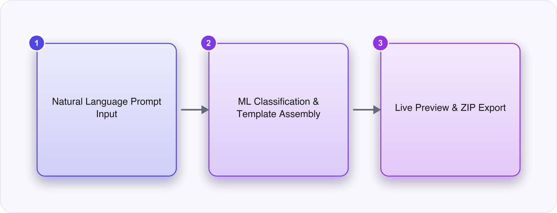
HIGH-LEVEL DIAGRAM
AI WEBSITE BUILDER

Slide 10
08 · SYSTEM DESIGN
Application Flow
01
02
03
04
05
Prompt Input
Classification
Slot Extraction & Theming
Template Assembly
Preview & Export
(To be added)
About Project screen is accessible anytime from the Home Screen.
Screenshot to be added
Screenshot to be added
AI WEBSITE BUILDER
09
Notes:
Walk the five stages; note the loop runs continuously.

Slide 11
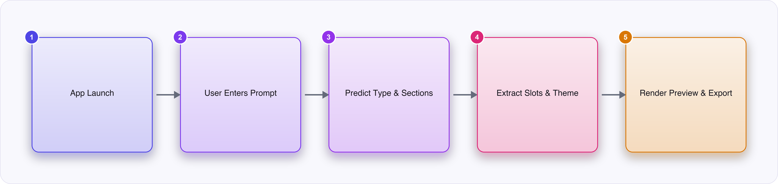
FLOW CHART
AI WEBSITE BUILDER

Slide 12
09 · MODEL IMPLEMENTATION
Model Implementation & Training
1. Dataset & Classifier Training
2. Extraction & Theme Rules
3. Template & Render Pipeline
4. Preview, History & Export
Hand-labelled prompts trained into TF-IDF + logistic regression models for type and sections.
Wrote regex patterns and tone-to-palette mappings for name, contact, and styling.
Built the Jinja2 section library and assembler producing live HTML/CSS/JS.
Wired up the sandboxed preview iframe, SQLite history, and ZIP export.
OUTCOME
A working Flask pipeline that turns a typed description into a previewable, editable, and exportable multi-section website in under half a second.
AI WEBSITE BUILDER
10
Notes:
Four build phases from dataset to integrated app.

Slide 13
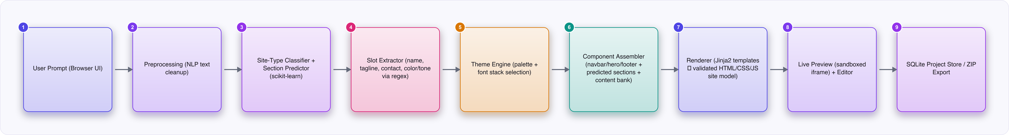
ARCHITECTURE DIAGRAM
AI WEBSITE BUILDER

Slide 14
10 · FUTURE SCOPE
Future Scope & Enhancements
Larger Labelled Dataset
Expand the hand-labelled prompt set to improve accuracy on thin classes like blog and education.
Richer Template Variety
Add more section layouts per site type to reduce visual sameness between similar sites.
Smarter Slot Extraction
Move beyond fixed regex patterns to catch names and contacts phrased unconventionally.
Optional Cloud Hosting
Add an opt-in deployment path for users who want their exported site live on the web.
Multi-User Accounts
Introduce login and per-user project storage beyond the single-user local scope.
AI WEBSITE BUILDER
11
Notes:
Five extensions beyond the FYP scope.

Slide 15
11 · CONCLUSION
Conclusion
The project delivers a working local AI Website Builder that turns a plain-English prompt into a themed, responsive, exportable website using lightweight, fully explainable ML and rule-based logic in place of the base paper's transformer/RL pipeline.
Two scikit-learn classifiers reliably predict site type and sections from free text.
Rule-based extraction and theming fill in name, contact, and style details.
Live preview renders a complete responsive site in milliseconds.
Exported ZIP runs fully offline with no server or internet needed.
IMPACT
Gives students, individuals, and small businesses a free, instant, and transparent way to get a professional-looking website without coding skill, design budget, or waiting on a developer.
THANK YOU
AI WEBSITE BUILDER
12
Notes:
Summarise the four deliverables and close on impact.

